Slide 1
OS-level Side Channels without Procfs: Exploring Cross-App Information Leakage on iOS
Xiaokuan Zhang¹, Xueqiang Wang², Xiaolong Bai³,
Yinqian Zhang¹ and XiaoFeng Wang²
¹The Ohio State University, ²Indiana University Bloomington, ³Tsinghua University
Notes:
Hello everyone. My name is Xiaokuan Zhang. I am from the Ohio State University. Today, I am going to present my paper, “OS-level Side Channels without Procfs:Exploring Cross-App Information Leakage on iOS”. This is a joint work with Xueqiang Wang and Prof. XiaoFeng Wang from Indiana University, Xiaolong Bai from Tsinghua University, and my advisor, Prof. Yinqian Zhang from the Ohio State University.

Slide 2
Mobile Side-Channel Attacks
Side-channel Attack: make use of seemingly harmless information to infer sensitive information
Cache Side Channels
Sensor-based Side Channels
OS-level Side Channels
Notes:
Side-channel attacks are attacks that make use of seemingly harmless information to infer sensitive information. Mobile side-channel attacks are side-channel attacks on smartphones, which mainly have three categories. The first one is Cache Side channels, where the attacker and the victim share CPU caches; The second one is Sensor-based side channels, where the attacker can learn the victim’s information via sensor readings. Such sensors include GPS, accelerometers, gyroscopes, etc. The third one is OS-level side channels, where the attacker can infer sensitive information through publicly accessible interfaces and APIs. In this paper, we focus on OS-level side channels.

Slide 3
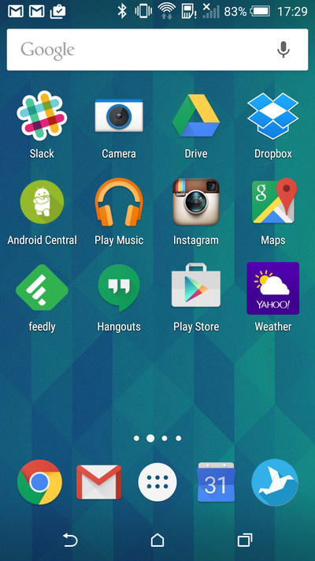
OS-level Side-Channel Attacks on Android
Malicious app running in the background, calling APIs
Procfs: system statistics
virtual/physical memory, network traffic, CPU usage info, …
Notes:
Let’s first take a look at OS-level side-channel attacks on Android. The typical threat model is that the malicious app controlled by the attacker is running in the background in the victim’s device, calling APIs to learn information about the user’s activity. Android system has a procfs pseudo file system that provides system information such as virtual/physical memory usage, network traffic info, CPU usage, etc. Most of Android side-channel attacks utilize the procfs by querying some per-app information files frequently to learn the user’s activity. As a result, Android gradually removes information in procfs to reduce the attack surfaces.

Slide 4
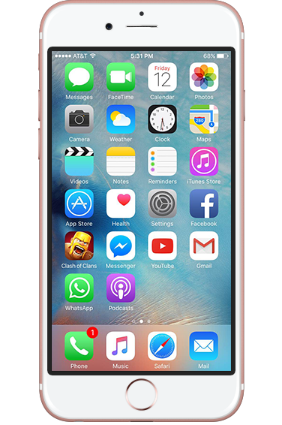
OS-level Side-Channel Attacks on iOS
No Procfs providing system stat
No unauthorized cross-app query
Is it possible to conduct OS-level side-channel attacks on iOS?
Notes:
Now let’s switch to IOS. iOS does not have a procfs, essentially shutting down the main avenue for the Android-style inference attacks. Since iOS 9, Apple has forbidden a sandboxed app to access information about other running processes. As a result, it is impossible today to conduct a side-channel analysis on iOS by exploiting per-app statistics, which completely defeats most demonstrated attacks on Android. Therefore, to our knowledge, there was no reported OS-level side-channel attack on iOS. So, is it possible to conduct OS-level side-channel attacks on IOS? (Pause) The short answer is YES, and I will show how this can be done in my presentation.

Slide 5
Outline
Side-channel Attack Vectors on iOS
Attack 1: Classifying User Activities
Attack 2: Detecting Sensitive In-App Activities
Attack 3: Bypassing Sandbox Restrictions
Practical Issues
Countermeasures
Conclusion
Notes:
Here is the outline of my presentation. I will first introduce the threat model and attack vectors on IOS, then talk about 3 categories of attacks. After that, I will present the practical issues and countermeasures, then the conclusion. Now, let’s look at threat model.
3’

Slide 6
Threat Model
Monitoring app:
User downloads it from App Store
Audio player
Notes:
Our threat model is that the attacker publishes a monitoring app in the Apple store, and the user downloads it onto his phone. The app is disguised as an Audio player. In other words, this app is similar to other music-playing apps, such as Spotify, Pandora, and IheartRadio.

Slide 7
New Attack Vectors
Host_statistics64(): Global usage of memory resources
Getifaddrs(): Global network resources
[NSFileManager fileExistsAtPath:]: The existence of a file/directory
Notes:
Here are the new attack vectors in IOS we found. First is host_statistics64. It shows the global usage of memory resources. Second one is get if addrs. It shows the global network traffic. The third one is the file exist at path method of the NSFileManager class. It can be used to test the existence of a file or directory. Later in my presentation, I will show how these APIs can leak side-channel information.

Slide 8
Outline
Side-channel Attack Vectors on iOS
Attack 1: Classifying User Activities
Attack 2: Detecting Sensitive In-App Activities
Attack 3: Bypassing Sandbox Restrictions
Practical Issues
Countermeasures
Conclusion
Notes:
Now let’s go to the first attack, classifying user activities.

Slide 9
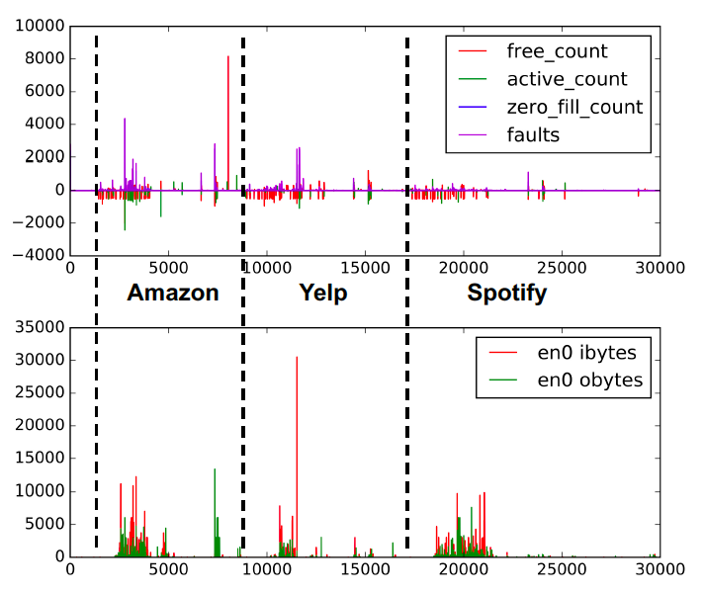
Classifying User Activities --- Example Trace
VM
Calling APIs to get time series A
Host_statistics64()
Getifaddrs()
Plotting diff series: A[i] – A[i-1]
Network
Time series leak
information!!!
Notes:
This figure shows the process of launching Amazon, Yelp and Spotify consecutively on IOS. We call host_statistic64 and get if addrs to get global virtual memory and network traffic time series, and we plot the diff series in this figure. This figure clearly shows that for different Apps, there is a different pattern. Therefore, time series leak information of user activities. In this case, the foreground app information is leaked.

Slide 10
Classifying User Activities --- Example Trace
How to combine multiple time series to perform inference attacks?
VM
Network
Notes:
So, how to combine multiple time series to perform inference attacks?

Slide 11
Classifying User Activities --- Example Trace
How to combine multiple time series to perform inference attacks?
VM
Requirements:
Combining multiple time series
Reducing the dimension
Major components:
SAX (Keogh et al., 2002)
BOP (Lin et al., 2009)
LibSVM (Chang et al., 2011)
Network
Notes:
The method should be able to combine multiple time series and reduce the dimension of the data. Previous work mainly deals with 1-dimensional time series. Our method has three major components, SAX, BOP, and libSVM. For the sake of time, please refer to our paper for the technical details. Let’s look at the case studies now.

Slide 12
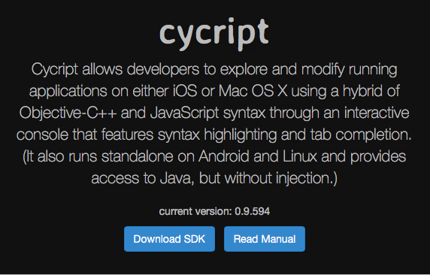
Classifying User Activities --- Case Studies
Device: jailbroken iPhone 7 with iOS 10.1.1
Automated using Cycript
Monitoring app:
running in the background
calling APIs at a rate of 1000/s
Notes:
We used a jailbroken iphone 7 with IOS 10.1.1 for the experiments. Jailbroken phone is used only because we want to automate the process. It is not a requirement for our attack. Later in the practical issues, I will talk about experiments on non-jailbroken phones.
Our monitoring app is running in the background, and it collects the first 5 second data points after app launching by calling the APIs at a rate of 1000 times per second. The target app was terminated after each round.
6’

Slide 13
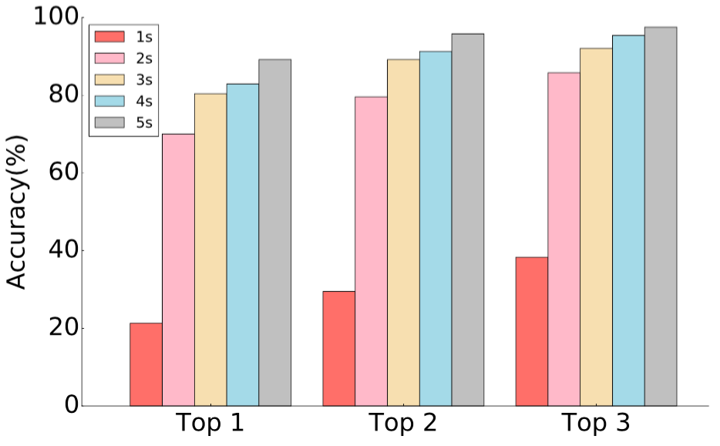
Classifying User Activities --- Case Studies
Foreground Apps:
100 apps from Top Charts + 20 pre-installed apps
Top N accuracy: the percentage of the test samples being correctly labeled by one of the top N predicted classes by the classifier
89.2%
97.5%
Notes:
Our first case study is identifying the foreground applications. We downloaded 100 apps from the Top charts in App Store, and selected another 20 pre-installed iOS apps. We used “Top N accuracy” to evaluate our result.
We can see that for 5 seconds data, the Top 1 accuracy is about 90%. the Top 3 accuracy is 97.5%.

Slide 14
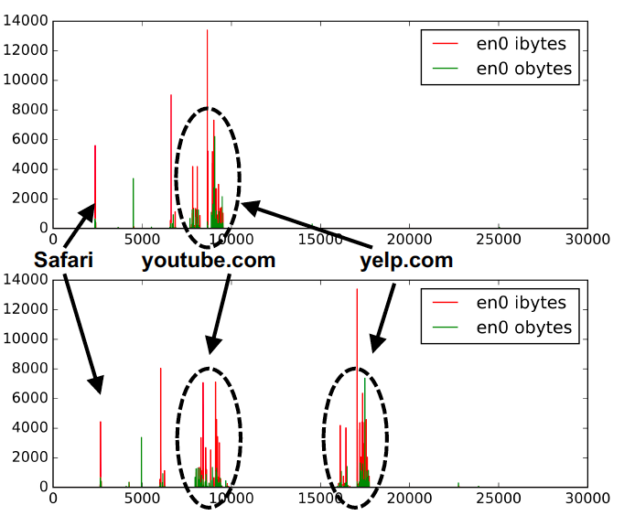
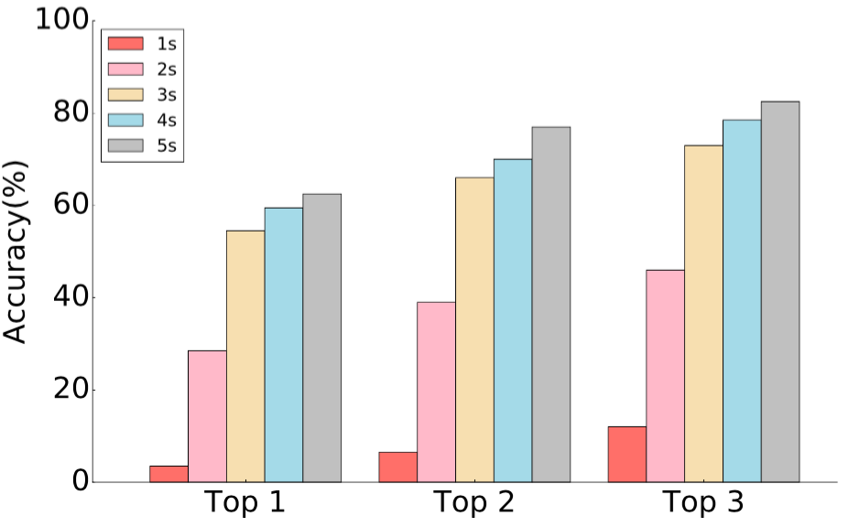
Classifying User Activities --- Case Studies
Safari Websites
84.5%
Notes:
The same method can also be applied to inferring the website that the user is visiting via Safari. We can achieve about 85% Top 3 accuracy for 5 seconds data.
Besides these two cases, we also have another example about the Apple Maps in our paper. If you are interested, please refer to our paper.

Slide 15
Outline
Side-channel Attack Vectors on iOS
Attack 1: Classifying User Activities
Attack 2: Detecting Sensitive In-App Activities
Attack 3: Bypassing Sandbox Restrictions
Practical Issues
Countermeasures
Conclusion
Notes:
Let’s go to the second attack, detecting sensitive in app activities.

Slide 16
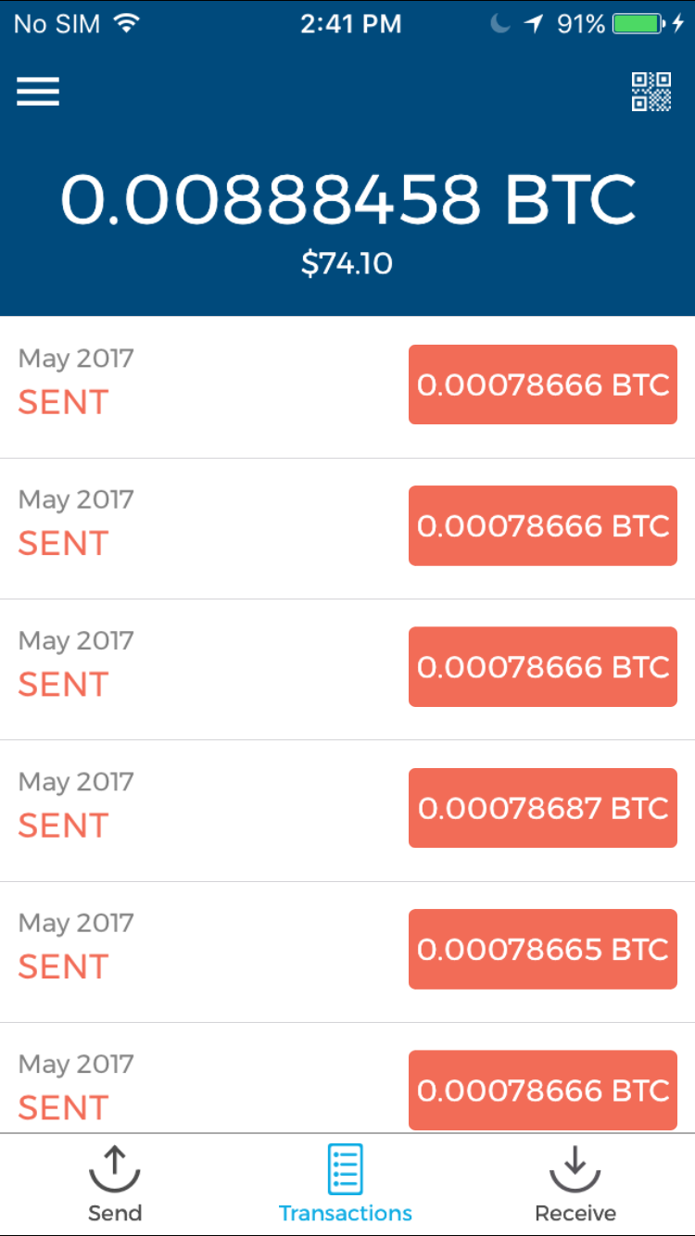
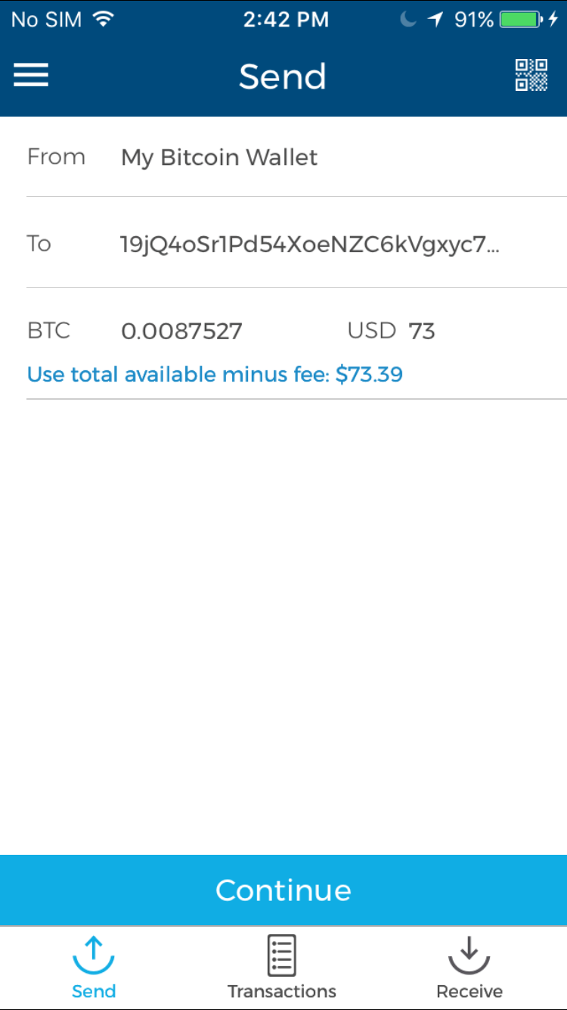
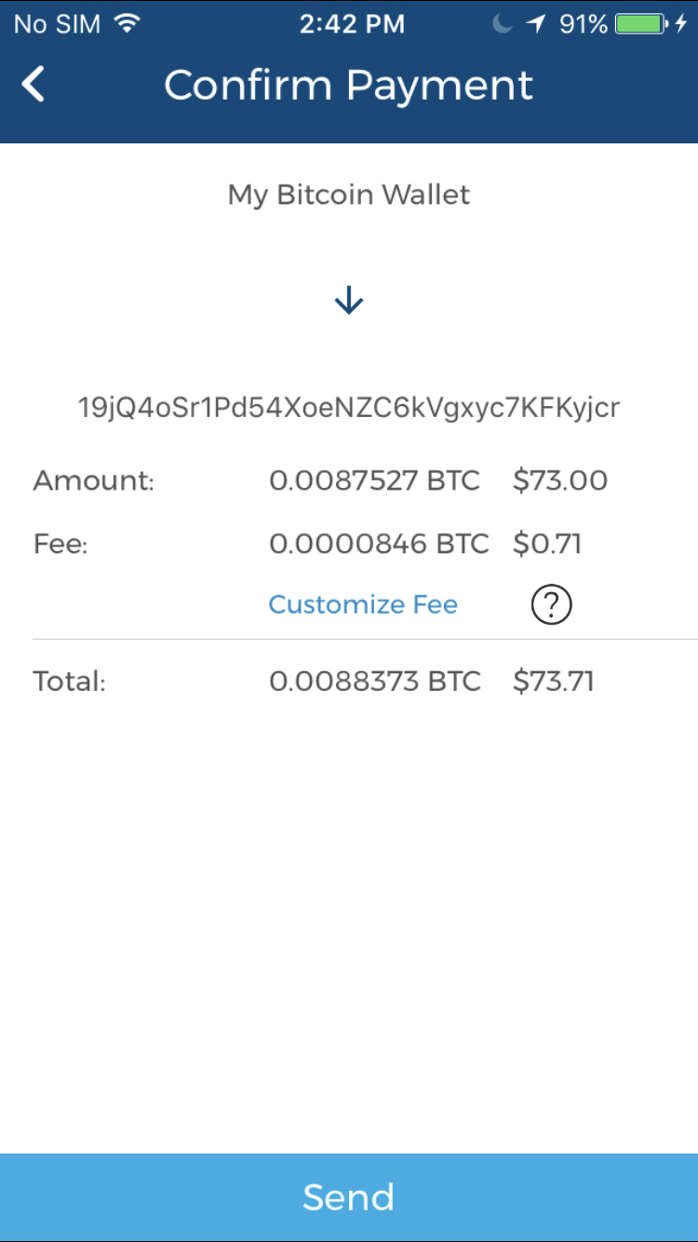
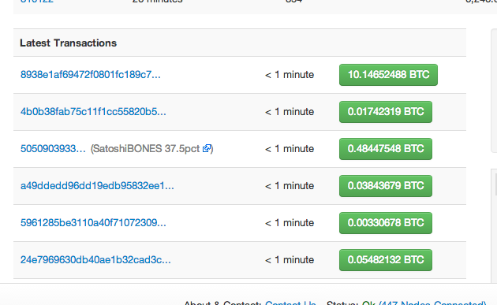
Detecting Sensitive In-App Activities
Blockchain.info
Notes:
Some in app activities may leak user’s information. First, let’s look at an example of in-app activities. This is the Blockchain Wallet app after logging in. It is a finance app that performs transactions on Bitcoin instead of real money.
If we click the send button, it will jump to the send page, asking the user to enter the receiver’s address and the amount of bitcoin to send. After that, by pressing continue, we go to the confirmation page. Once we click send, the bitcoin will be sent to the receiver, and the transaction will be recorded, and is publicly available. Note that the bitcoin address is anonymized, and it changes each time a user makes a payment.

Slide 17
Detecting Sensitive In-App Activities --- Attack Methods
Identify critical events
Correlates with public records
Notes:
However, there is a record for each transaction. if we can identify the payment events, and record the timestamps, we can search the public records for correlation, and further bind bitcoin addresses to the user. The key here is to identify the payment event.

Slide 18
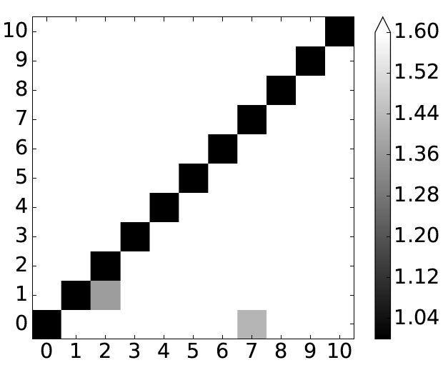
Detecting Sensitive In-App Activities --- Case Studies
Target: Blockchain Wallet App
Goal: identify payment event (idx: 0)
Notes:
For different UI, there will be a different virtual memory pattern. So, to identify the payment event, we used an extended DTW method to do the pattern matching based on VM traces, and the result is shown in the heatmap. Our goal is to identify the payment event, which is the index 0 in the heatmap. In this heatmap, each row and column represents one activity, and cell (i; j) represents the average distance between activity i and j.

Slide 19
Detecting Sensitive In-App Activities --- Case Studies
Target: Blockchain Wallet App
Goal: identify payment event (idx: 0)
Normalize the distance per row
using cell(i,i) as the base (diagonal)
Notes:
Note the distances are normalized in each row, so that the average distance between traces of the same activity is 1 and the distances from other activities are normalized accordingly. After normalization, the diagonal values are 1. Lighter color means larger distance. We can see that the distance between the payment event and others are quite large, so our method can easily identify the payment event.
9’

Slide 20
Detecting Sensitive In-App Activities --- Case Studies
Transaction
Set
Transaction
Set
Transaction
Set
Notes:
We also perform an empirical experiment by doing bitcoin transactions by ourselves. The basic idea is that we collect a list of timestamps of transactions. Then for each timestamp, we query the public bitcoin transactions database to find a transaction set, containing all transactions that happened around that time. After that, we can find the overlap of bitcoin addresses, which are the ones that belong to this user.

Slide 21
Detecting Sensitive In-App Activities --- Case Studies
A sent 0.0035 BTC to B (1EwB…), The rest went to C (1Fbr…)
C sent 0.001 BTC to E (1yNT…), The rest went to D (1ANE…)
D sent 0.0028 BTC to F (1CeN…), The rest went to G (16rU…)
Notes:
Here are some example transactions of our experiment. We can see that there are connections, or common addresses, between them. Therefore, we are able to link bitcoin addresses to a certain device using this method.

Slide 22
Detecting Sensitive In-App Activities --- Case Studies
Other Targets: Venmo / Twitter
Notes:
We also conducted similar experiment on Venmo and Twitter, because they also have public database that we can correlate with. Please refer to our paper for details.

Slide 23
Outline
Side-channel Attack Vectors on iOS
Attack 1: Classifying User Activities
Attack 2: Detecting Sensitive In-App Activities
Attack 3: Bypassing Sandbox Restrictions
Practical Issues
Countermeasures
Conclusion
Notes:
Now, let’s go to the third attack, bypassing sandbox restrictions.

Slide 24
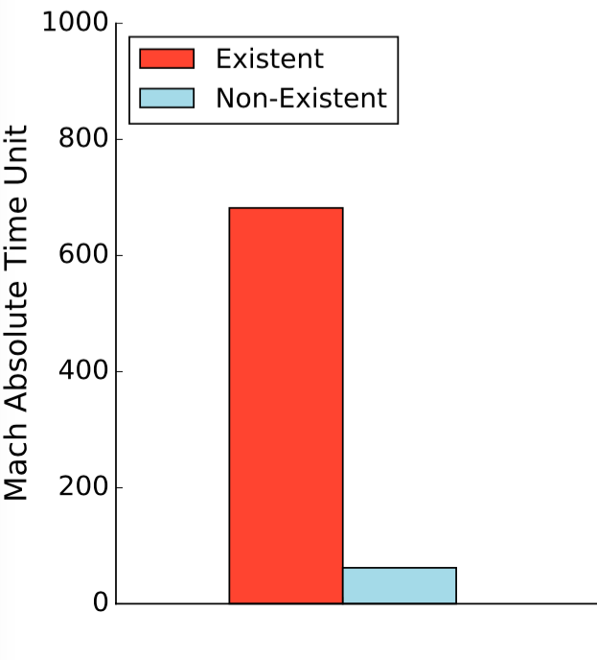
Bypassing Sandbox Restrictions --- Attack Methods
Device: non-jailbroken iPhone 7 with iOS 10.2.1
Execution time of FileExistAtPath
Huge Difference!!!
Notes:
We measured the execution time of the fileExistsAtPath API on a non-jailbroken iphone7 device running iOS 10.2.1. We test using an existent and non-existent file paths, which our app has no permission to access. Even though the API always returns FALSE, we can see that there is a huge timing difference. Therefore, we can use this timing channel to reliably detect whether a file exists or not. Now let’s look at our case studies to see how to utilize such a channel.

Slide 25
Bypassing Sandbox Restrictions --- Case Studies
Detect whether an app has been installed
DivorceForce
AsthmaMD
Pregnancy+
Sugar Sense
Notes:
First, it can be used to detect whether an app has been installed on the device, which may reveal private information of the user. Here are some examples of sensitive apps. DivorceForce can reveal your marital status; AsthmaMD can reveal your health information; Pregnancy+ may show that you or your close one is having a baby; Sugar Sense may show that you have diabetes.
So, why are we able to use the timing channel to detect the apps?

Slide 26
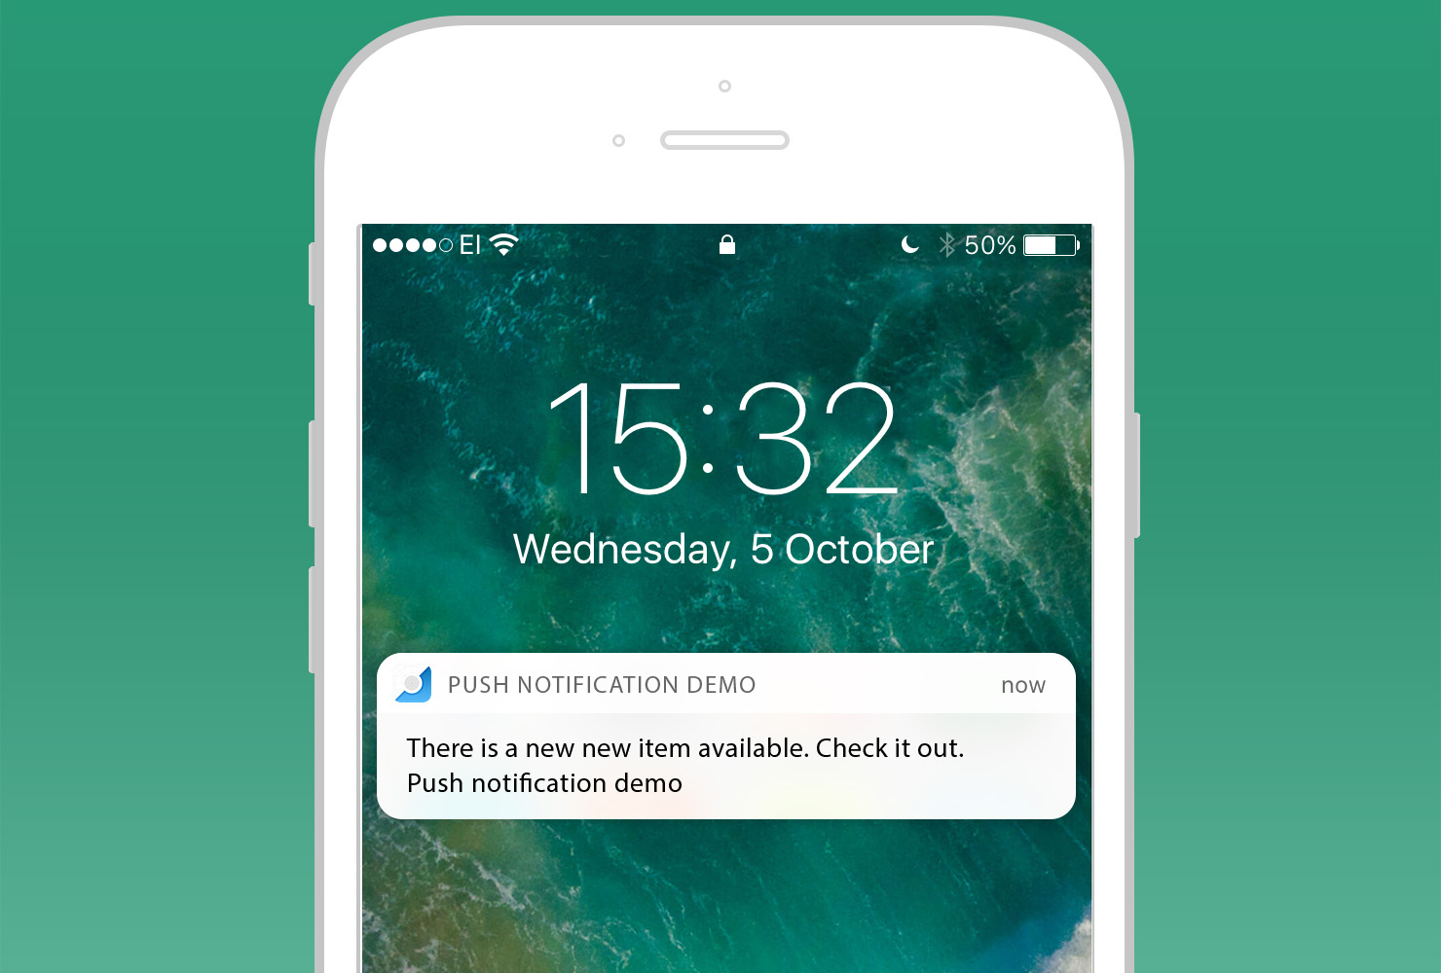
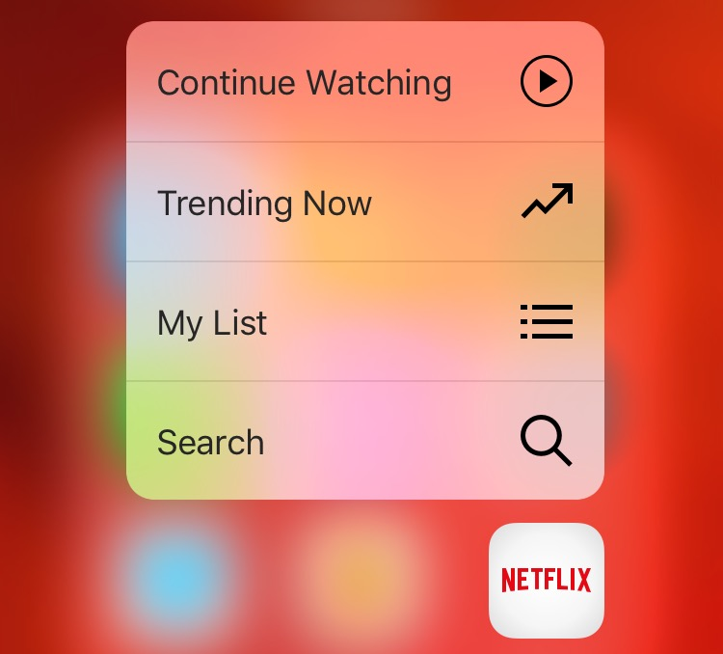
Bypassing Sandbox Restrictions --- Case Studies
Push notifications:
.pushstore file with the bundle identifier as its name will be created in a specific directory
(/var/mobile/Library/SpringBoard/PushStore/com.google.Gmail.pushstore for the Gmail app)
Dynamically registered home screen quick actions:
.plist file with the bundle identifier as its name will be created in a specific directory (/var/mobile/Library/SpringBoard/Application Shortcuts/com.google.Gmail.plist for the Gmail app)
Top 150 apps in App Store’s “Top Charts” (Aug. 2017):
Push notification: 67 (44.7%)
dynamically registered home screen quick actions: 44 (31.3%)
Notes:
The reason is that, if this app requires permission for sending push notifications, or it dynamically registers home screen quick actions, a file with specific name will be created. As a result, by detecting the existence of such files, we can learn whether such apps are installed.
We studied top 150 apps in App Store’s “Top Charts”, push notification was requested by 45% of the apps, and 31% have dynamically registered quick actions.
12’

Slide 27
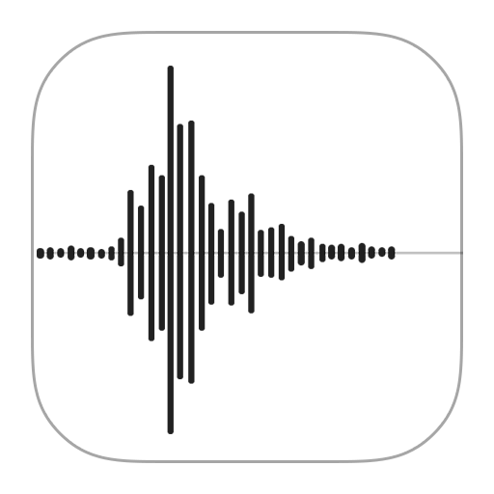
Bypassing Sandbox Restrictions --- Case Studies
Other cases: number of photos/memos
Generic approach to detect files
Notes:
This side channel can also be used to detect the number of photos and memos. There can be other case studies as well, since our method provides a generic way to detect the existence of files.

Slide 28
Outline
Side-channel Attack Vectors on iOS
Attack 1: Classifying User Activities
Attack 2: Detecting Sensitive In-App Activities
Attack 3: Bypassing Sandbox Restrictions
Practical Issues
Countermeasures
Conclusion
Notes:
Now let’s look at some practical issues.

Slide 29
Practical Issues
App Store Vetting
Disguised as an Audio Player
Passed the vetting
Power Consumption
Device: jailbroken iPhone 7 with iOS 10.1.1
60 min: 5% battery was consumed
Notes:
App Store Vetting. Our app is disguised as an Audio Player, and successfully passed the vetting. After our app was approved by Apple, we downloaded the app and withdrew it immediately.
Power consumption. We measured the power consumption of our monitoring app on a jailbroken iPhone7 with ios 10.1.1. After 60 minutes, only 5% of battery was consumed.

Slide 30
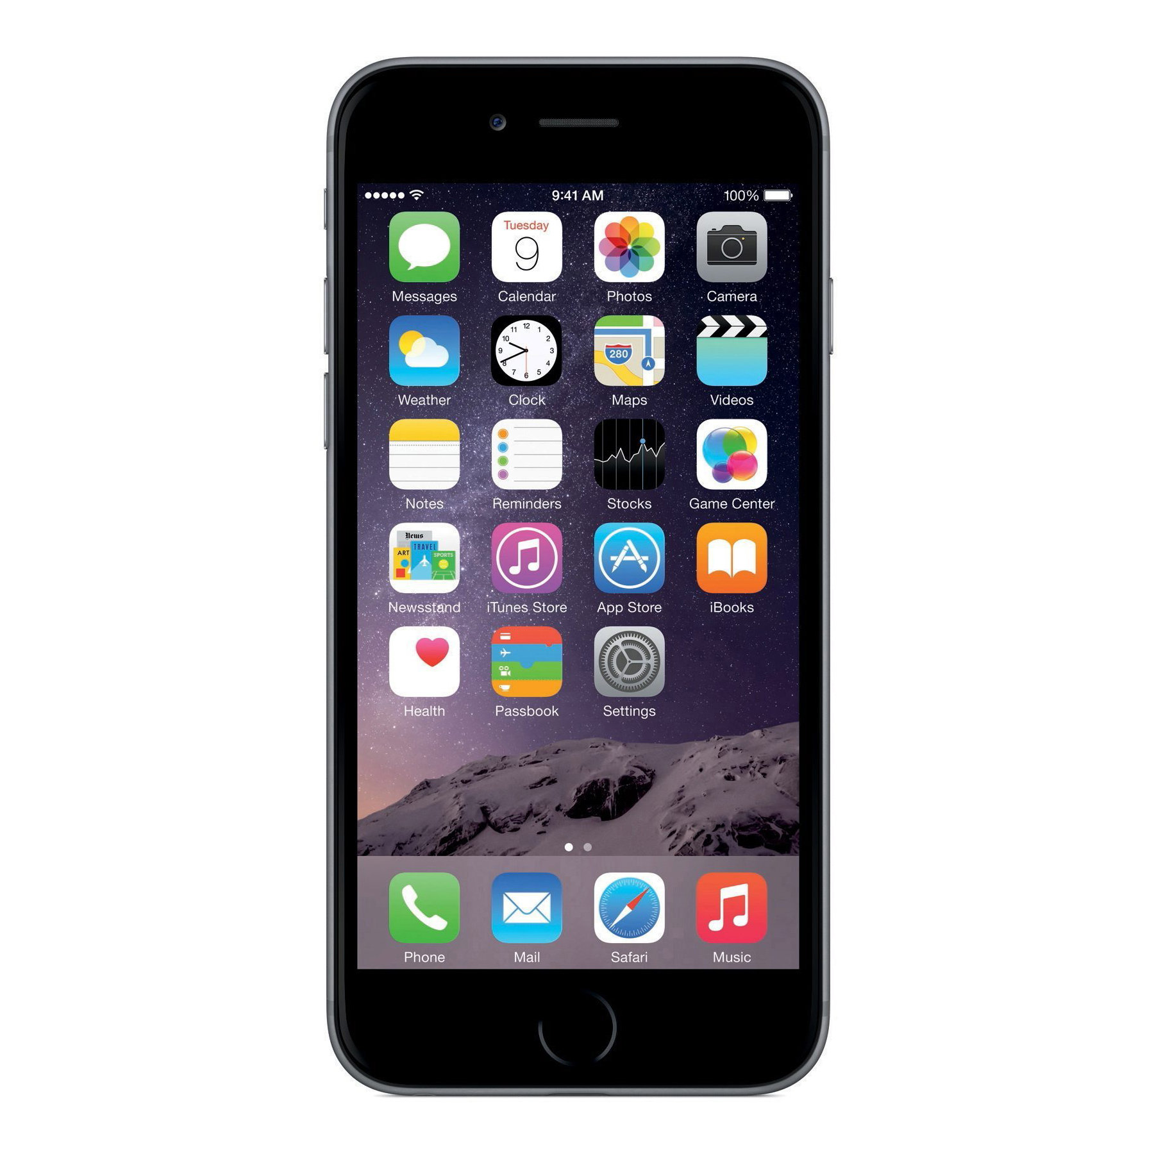
Practical Issues --- Cross-device Attack Feasibility
training device: Device A
iOS 10.1.1
testing device: Device B
Non-jailbroken iOS 10.2.1
Notes:
To demonstrate the practicality of our attacks, we manually collected traces on another non-jailbroken iPhone 7 running iOS 10.2.1. Then, we use previously collected data as training set or signature to re-evaluate the attacks. Note that the training traces were collected 20 days before the new test set, on a different device with a different iOS version.

Slide 31
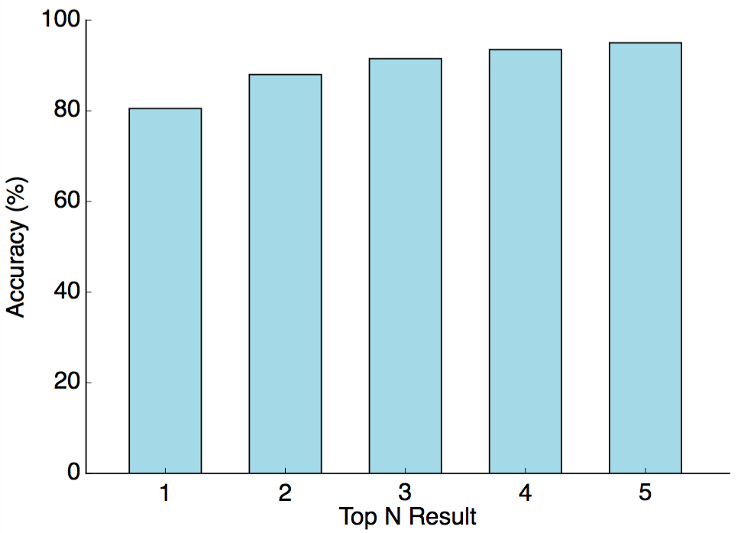
Practical Issues --- Cross-device Attack Feasibility
Test set: Randomly select 20 third-party apps
Redo Foreground Apps Experiment
91.5%
80.5%
Notes:
We randomly selected 20 third-party apps. Then we manually collected traces to construct a new test set. This figure shows the accuracy: 80.5% with Top 1 result, 91.5% accuracy for Top 3.

Slide 32
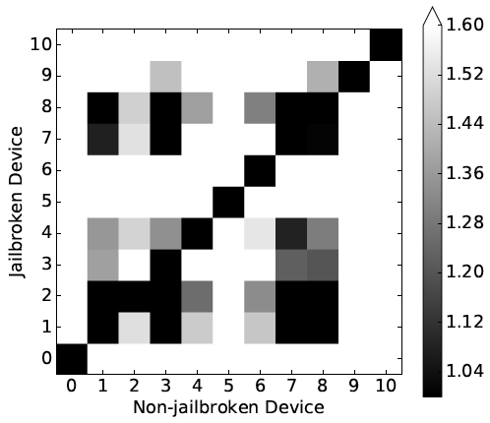
Practical Issues --- Cross-device Attack Feasibility
Target: Blockchain Wallet
Notes:
We also recollected trace of Blockchain Wallet and redid the evaluation. This time, x-axis means non-jailbroken (testing) device, and y-axis means jailbroken (training) device. We normalized the distance per row as mentioned before. It is noiser than the previous result, but the payment activity, index 0, can still be clearly distinguished.
From these experiments, we show that our demonstrated attacks are robust enough to be trained on a device owned by the attacker and then tested using the data collected from the victim’s device. Minor differences in the iOS versions and app versions can also be tolerated.

Slide 33
Outline
Side-channel Attack Vectors on iOS
Attack 1: Classifying User Activities
Attack 2: Detecting Sensitive In-App Activities
Attack 3: Bypassing Sandbox Restrictions
Practical Issues
Countermeasures
Conclusion
Notes:
Now let’s see the countermeasures we proposed in the paper.
16’

Slide 34
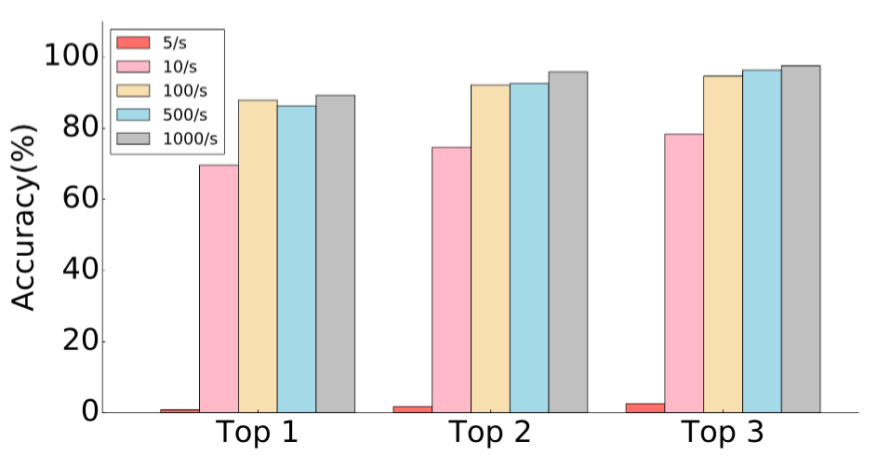
Countermeasures
Rate Limiting: limit the sampling rate
Filter the data and only keep every (1000/N)th data point
Re-evaluate the foreground app classification
Implemented in iOS 11.1 for host_statistics64(): 2/s
Notes:
In our attacks, the monitoring app calls the APIs at a rate of 1000 times per second. It is intuitive that rate limiting may be a good defense. Therefore, we filter the data and only keep the 1000 over N th data point, and re-evaluate foreground app classification.
Here is the result. We can see that even if the rate is limited to 10 per second, our method can still achieve about 70% top 1 accuracy. When the rate is 5 per second, our method no longer works. We reported this result to Apple, and rate limiting has been implemented in ios 11.1 for host_statistics_64. It is limited to twice per second.

Slide 35
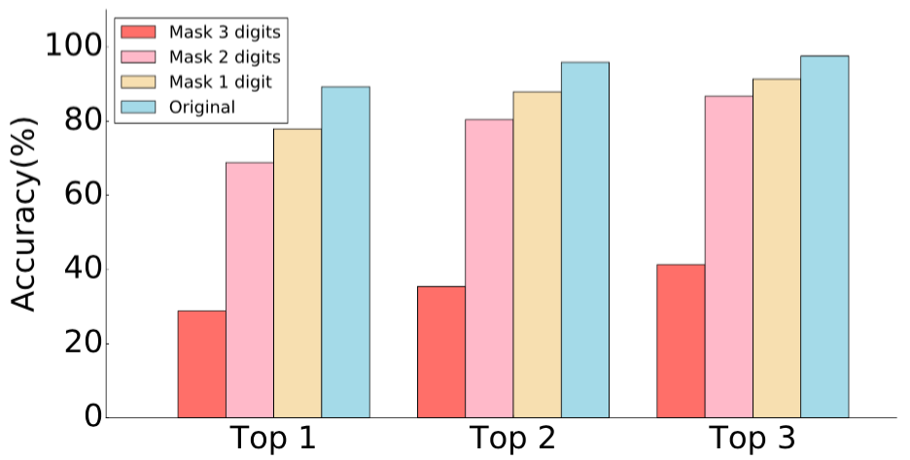
Countermeasures
Coarse-grained return values: masking the digits of return values
Mask 1/2/3 digits of all 6 features
Re-evaluate the foreground app classification
Original:
1234
Mask 1 digit:
1230
Mask 2 digits:
1200
Mask 3 digits:
1000
Notes:
Another countermeasure is to mask the digits of return values of these APIs. We can see that masking 3 digits can lower the accuracy drastically.

Slide 36
Countermeasures
Coarse-grained return values: masking the digits of return values
Mask 1/2/3 digits of all 6 features
Re-evaluate the foreground app classification
Implemented in iOS 11 for getifaddrs():
Round to 1KB
Notes:
Apple has implemented this approach for getifaddrs() in iOS 11 to round the values to 1K Bytes .

Slide 37
Countermeasures
Eliminating the attack vectors
Runtime detection
Privacy-preserving statistics reporting
Removing the fileExistsAtPath timing channel
fileExistsAtPath timing channel has been eliminated in iOS 11
Notes:
The timing channel of file exist at path has also been eliminated in iOS 11. There are some other possible countermeasures, such as removing the APIs, runtime detection, privacy-preserving stat reporting.

Slide 38
Outline
Side-channel Attack Vectors on iOS
Attack 1: Classifying User Activities
Attack 2: Detecting Sensitive In-App Activities
Attack 3: Bypassing Sandbox Restrictions
Practical Issues
Countermeasures
Conclusion
Notes:
Here comes the Conclusion.

Slide 39
Conclusion
First exploration of OS-level side channels on iOS
Three categories of side-channel attacks
Proposed countermeasures integrated in iOS and MacOS
Notes:
In this paper, we presented the first exploration of OS-level side channels on iOS.
We show three categories of side-channel attacks. These attacks showed that similar to Android, cross-app side-channel attacks on iOS are also feasible. Our study has helped Apple mitigate these security threats in iOS/MacOS.

Slide 40
Xiaokuan Zhang
zhang.5840@osu.edu
Notes:
Thanks for your attention. I am ready to take questions now.

